Slide 1
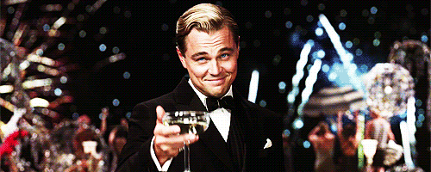
Symmetric Matrices and Quadratic Forms
6.4 The Singular Value Decomposition
Bumhee Cho

Slide 2
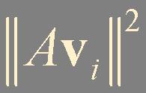
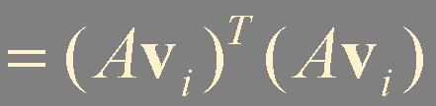
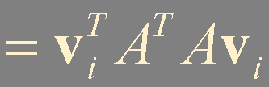
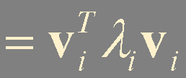
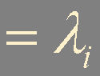
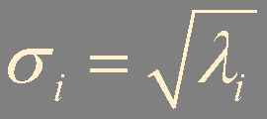
The Singular Values of an m × n Matrix
Let A be an m × n matrix
A^{T}A is a n × n symmetric matrix
(A^{T}A)^{T}
= A^{T}A^{TT} = A^{T}A
A^{T}A is orthogonally diagonalizable
P = [ v₁ … v_{n} ]
{v₁, …, v_{n}} is orthonormal basis for ℝ^{n}, consisting of eigenvectors of A^{T}A
λ₁, … , λ_{n} be the associated eigenvalues of A^{T}A
nonnegative !
λ₁ ≥ λ₂ ≥ ⋯ ≥ λ_{n} ≥ 0
The singular values of A are
the square roots of the eigenvalues of A^{T}A
Notes:
중요 포인트
임의의 m by n A matrix의 A^{T}A 는 항상 symmetric
singular value 정의 : A^{T}A의 eigenvalue들의 square root 값, 역시 항상 0이상; A의 eigenvalue가 아님

Slide 3
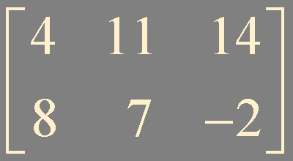

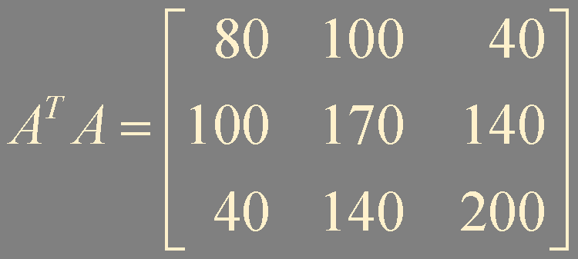
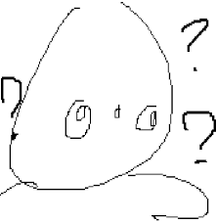
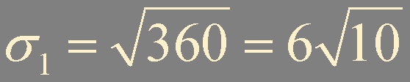
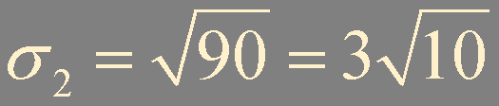
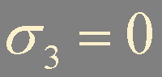
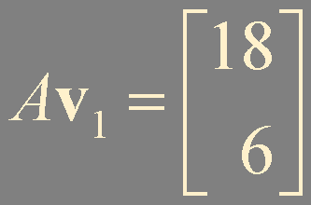
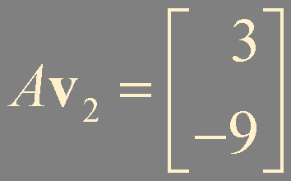
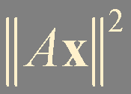
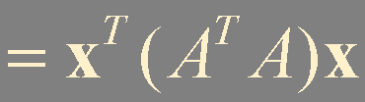
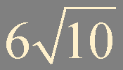
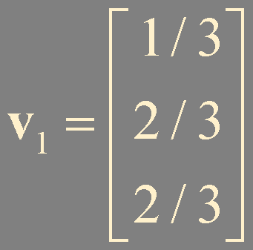
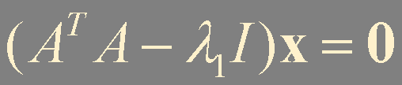
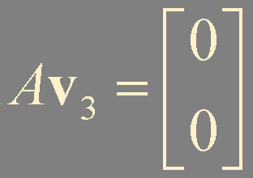
!
?
Let A = , find the singular values of A and find a
unit vector x at which the length ||Ax|| is maximized.
Example 1
eigenvalues
characteristic equation
λ₁ = 360 λ₂ = 90 λ₃ = 0
subject to ||x|| = 1
a unit eigenvector
corresponding to λ₁
orthogonal
Notes:
constrained optimization 단원에서 배운걸 그대로 적용하여,
quadratic form의 ||x||=1 제약조건하에서의 최대값을 응용하면 ||Ax||의 최대값을 쉽게 구할 수 있다.
주의해야할 점은 역시 ||Ax||의 최대값은 quadratic form x^{T}(A^{T}A)x 의 최대값의 square root 라는 점이다.
A^{T}A의 eigenvector들을 살펴보니 특이한 점이 발견된다. Av_{i} 들이 orthogonal 하다…!

Slide 4
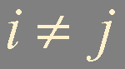
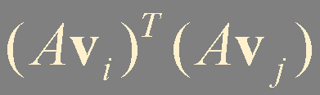
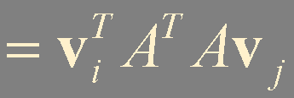
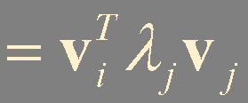
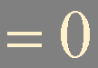
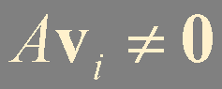

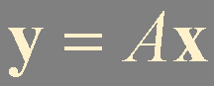
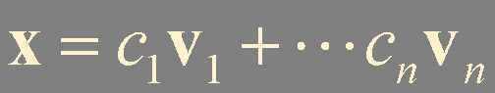
Theorem 9.
Let {v₁, …, v_{n}} is orthonormal basis of ℝ^{n} consisting of eigenvectors of A^{T}A,
arranged so that the corresponding eigenvalues of A^{T}A satisfy λ₁ ≥ ⋯ ≥ λ_{n}, and
m < n
suppose A has r nonzero singular values.
undetermined
rank A ≤ m
Then {Av₁, …, Av_{r}} is an orthogonal basis for Col A, and rank A = r.
r ≤ m
m > n
{Av₁, …, Av_{n}} is an orthogonal set
overdetermined
{Av₁, …, Av_{r}} is a linearly independent set
r ≤ n < m
y in Col A
Notes:
Col A에 있는 임의의 y 벡터는 Av₁, … , Av_{r} 의 linear combination으로 표현이 된다.
그리고 {Av₁, … , Av_{r}}은 linearly independent set이고, orthogonal 하다.
그러므로, {Av₁, … , Av_{r}}은 Col A의 orthogonal basis 이며, Col A의 dimension인 rank A는 r이 된다.
n>m 인 경우엔 rank A ≤ m (한번 생각해보시길..!), 그러므로 r ≤ m.
예를 들어, m=2, n=3 인경우 (예제 1번과 같이)엔 r ≤ 2, singular value는 총 3개가 있고, 그러므로 최소한 1개는 무조건 0이 된다.

Slide 5
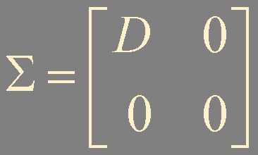
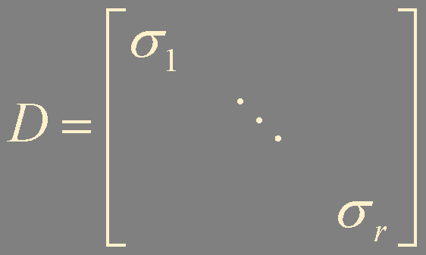

m × n
m - r
(a)
n - r
Theorem 10. The Singular Value Decomposition (SVD)
Let A be an m × n matrix with rank r.
Then there exists an m × n matrix Σ as in (a) for which the diagonal entries in D are the first r singular values of A,
σ₁ ≥ σ₂ ≥ ⋯ ≥ σ_{r} > 0,
and there exist an m × m orthogonal matrix U and an n × n orthogonal matrix V such that
A = U Σ V ^{T}
columns of U: left singular vectors of A
columns of V: right singular vectors of A
Notes:
orthogonal matrix는 column vector들이 orthonormal 한 관계에 있는 matrix. (강좌 5.2 Orthogonal Set 에 나온 내용)
U와 V는 unique 하게 결정되지 않는다.
하지만 Σ의 entry들은 반드시 singular value들이여야 한다.

Slide 6

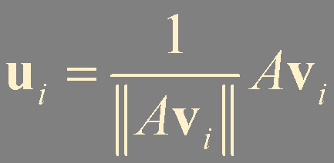
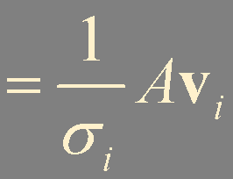
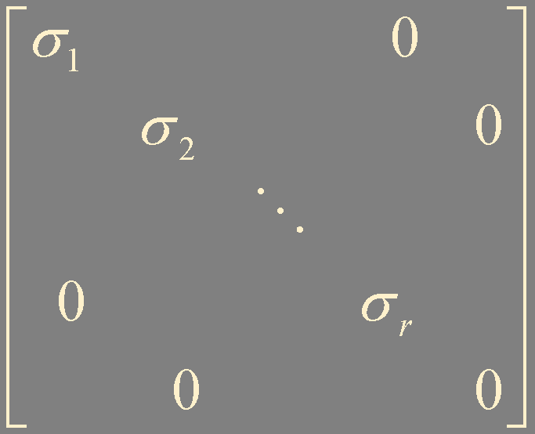
in ℝ^{m}
{Av₁, …, Av_{r}} is an orthogonal basis for Col A
v_{i} in ℝ^{n}
Normalize {Av₁, …, Av_{r}}
{u₁, …, u_{r}}
AV = U Σ
u_{i} in ℝ^{m}
r ≤ m
A = U Σ V ^{T}
Extend {u₁, …, u_{r}} to an orthonormal basis {u₁, …, u_{m}} of ℝ^{m}
m × m
V = [ v₁ v₂ ⋯ v_{n} ]
Let U = [ u₁ u₂ ⋯ u_{m} ]
n × n
n
AV = [ Av₁ Av₂ ⋯ Av_{n} ]
= [ Av₁ ⋯ Av_{r} 0 ⋯ 0 ]
U Σ = [ u₁ u₂ ⋯ u_{m} ]
m
= [ σ₁u₁ ⋯ σ_{r}u_{r} 0 ⋯ 0 ]
n - r
= [ σ₁u₁ ⋯ σ_{r}u_{r} 0 ⋯ 0 ]

Slide 7
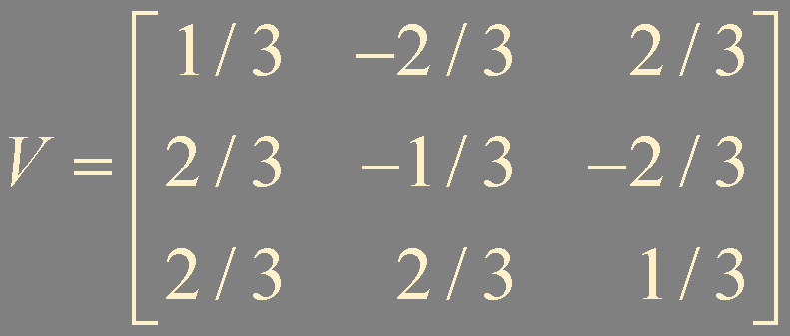
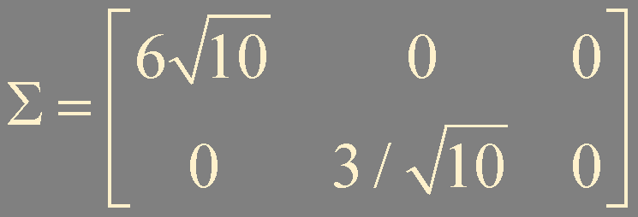
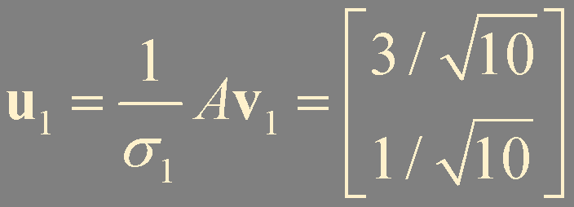
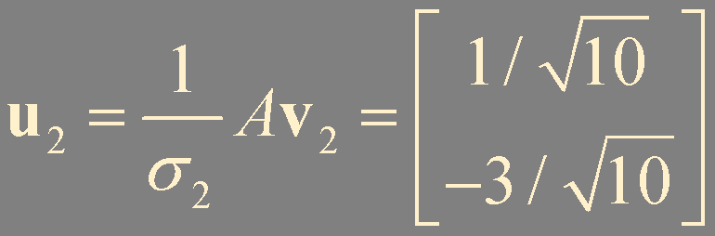
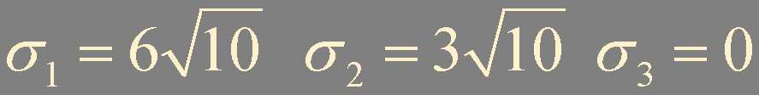
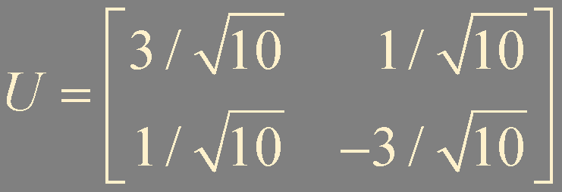
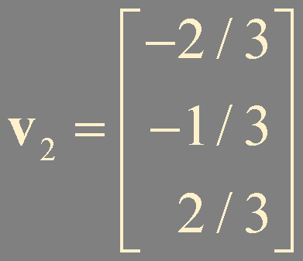
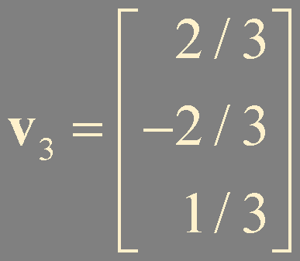
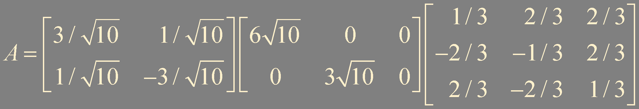
!
?
Let A = , construct a singular value decomposition of A.
Example 2
U: 2 × 2 Σ: 2 × 3 V: 3 × 3
Orthogonal diagonalization of A^{T}A
characteristic equation
|A^{T}A - λI| = 0
Eigenvalues
λ₁ = 360 λ₂ = 90 λ₃ = 0
rank A = 2
Orthonormal eigenvectors (A^{T}A - λI)x = 0
{u₁, u₂} spans ℝ²
(Gram-Schmidt if necessary)
Notes:
Eigenspace의 dimension이 1보다 큰 경우엔, Gram-Schmidt 과정이 필요함.

Slide 8
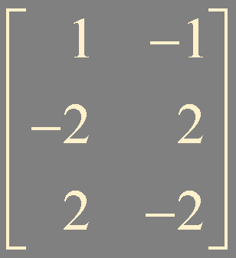
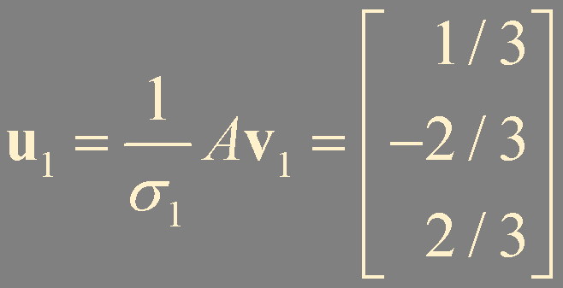
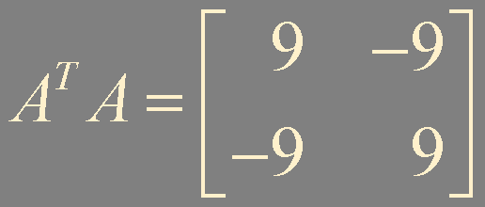
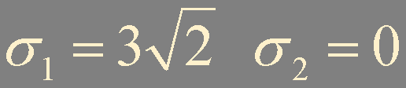
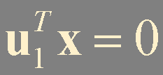
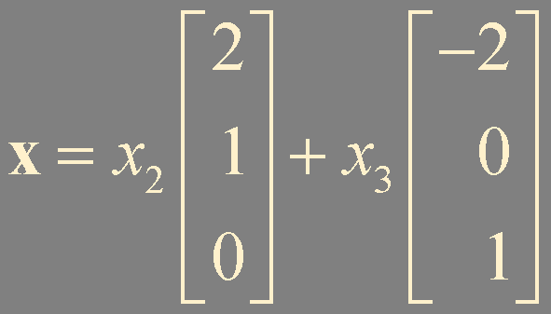
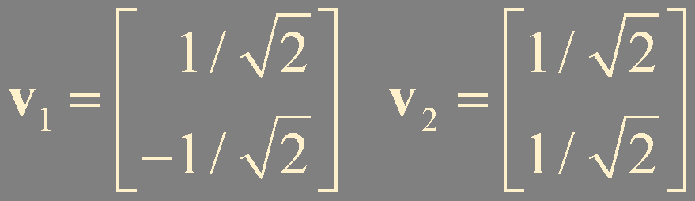




?
!
Let A = , construct a singular value decomposition of A.
Example 3
U: 3 × 3 Σ: 3 × 2 V: 2 × 2
u₁
Find u₂ and u₃
u₃
{u₁, u₂, u₃} orthonormal basis of ℝ³
λ₁ = 18 λ₂ = 0
rank A = 1
u₂
u₂ and u₃ satisfy
{u₁, w₂, w₃} basis of ℝ³
w₂
w₃
not orthonormal
V = [ v₁ v₂ ]
Gram-Schmidt
Notes:
orthonormal basis 찾는 테크닉은 여러가지가 있을 수 있음.
임의의 ℝ³ 벡터를 잡은뒤 Gram-Schmidt 과정으로 orthogonal set을 찾을 수 있음.
이때 Gram-Schmidt 과정으로 나온 결과가 zero 벡터인 경우엔 (잡았던 임의의 벡터가 linearly dependent 하다는 의미) 다른 지점의 벡터를 잡아서 다시 수행을 해주면 됨.
찾은 orthogonal set을 normalize를 통하여 orthonormal set으로 만들면 됨.

Slide 9
Bases for Fundamental Subspaces
A = U Σ V ^{T}
A: m × n U: m × m Σ: m × n V: n × n
rank A = r
Normalize
{Av₁, …, Av_{r}}
u₁, …, u_{r} :
left singular vectors
v₁, …, v_{n} :
right singular vectors
{u₁, …, u_{r}}: orthonormal basis for Col A
Av_{r+1} = 0 ⋯ Av_{n} = 0
in Nul A
rank A = r
dim Nul A = n - r
Ch5.1 Theorem 3.
(Row A)⊥ = Nul A
(Col A)⊥ = Nul A^{T}
{v_{r+1}, …, v_{n}}: orthonormal basis for Nul A
{u_{r+1}, …, u_{m}}: orthonormal basis for Nul A^{T}
{v₁, …, v_{r}}: orthonormal basis for Row A

Slide 10
ℝ^{n}
ℝ^{m}
multiplication by A
v₁
σ₁u₁
Col A = Row A^{T}
Row A
v₂
σ₂u₂
…
…
…
v_{r}
σ_{r}u_{r}
0
0
v_{r+1}
u_{r+1}
…
…
Nul A
u_{m}
Nul A^{T}
v_{n}

Slide 11




Example 3
rank A = 1
u₂ and u₃ in (Col A)⊥
Nul A
v₂
A
v₁
Row A

Slide 12
Theorem. The Invertible Matrix Theorem (concluded)
Let A be an n × n invertible matrix. Then the following statements are equivalent.
u. (Col A)⊥ = {0}
v. (Nul A)⊥ = ℝ^{n}
w. Row A = ℝ^{n}
x. A has n nonzero singular values

Slide 13


Reduced SVD
A = U Σ V ^{T}
U = [ u₁ ⋯ u_{m} ]
V = [ v₁ v₂ ⋯ v_{n} ]
m - r
= [ V_{r} V_{n - r} ]
= [ U_{r} U_{m - r} ]
n - r
U_{r} = [ u₁ ⋯ u_{r} ]
V_{r} = [ v₁ ⋯ v_{r} ]

Slide 14










Pseudoinverse (the Moore-Penrose Inverse)
Ch5.3 Theorem 10.
If {u₁,…, u_{p}} is an orthonormal basis for a subspace W of ℝ^{n}, then
Ch5.2 Theorem 6.
proj_{W} y = (y⋅u₁)u₁ + (y⋅u₂)u₂ + ⋯ + (y⋅u_{p})u_{p}
An m × n matrix U has orthonormal columns if and only if
If U = [u₁ u₂ ⋯ u_{p}], then
U ^{T}U = I.
proj_{W} y = U U ^{T} y for all y in ℝ^{n}
orthogonal projection of b onto Col A
is a least-squares solution of Ax = b !
has the smallest length among all least-squares solutions of Ax = b

Slide 15


Applications
least-square solution
data analysis (Covariance matrix)
image / sound processing
is small enough
Truncated SVD

Slide 16





Example of Image Processing
510 × 340 = 173,400 pixels
Truncated SVD
5 × 510 + 5 + 5 × 340 = 4,255 pixels (2.45 %)
50 × 510 + 50 + 50 × 340 = 42,550 pixels (24.5 %)
100 × 510 + 100 + 100 × 340 = 85,100 pixels (49.1%)

Slide 17
Summary
SVD
Reduced SVD
Pseudoinverse

